Slide 1
What is Success?
By Ryan, Kirsty and Paul.

Slide 2

What is Success?
Who would you describe as successful?
Why do you believe they are successful?
What is their success?
Is there a difference between success and happiness?

Slide 3

Inspirations and Personal Influences
Who are your inspirations in life?
How do they influence your life?

Slide 4

Ambitions, Goals and Motivation
What are your ambitions in life?

Slide 5

Personal Motivation
Why are you doing this course?
What will keep you motivated?
What may de-motivate you?

Slide 6

Personal values and Qualities
What are your personal values?
Values you admire and would aspire to gain..
What personal qualities do you have that will lead to success?

Slide 7
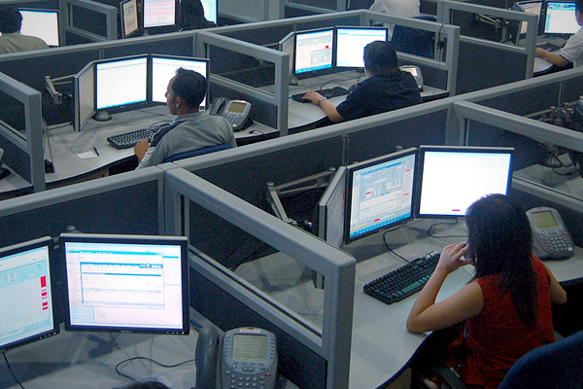
Future
Where do we see ourselves in the future?
in a job hopefully.

